Slide 1

Remix at the heart of a laser
Yuchao Jiang
Feb.21,2017
Notes:
A short presentation after watching “everything is a remix” on Nerdy movie night.

Slide 2
Something about me
Ph.D. in Electrical and Computer Engineering
made in China
repurposed in U.S.
recycled in Mars?
2 quick surveys
Notes:
How many of you have heard something about the Curiosity Rover on Mars? Such landing on Mars and how Curiosity zapping a rock.
How many of you may want to travel to Mars, if given free tickets for your whole family, and all the fancy technologies on earth?

Slide 3
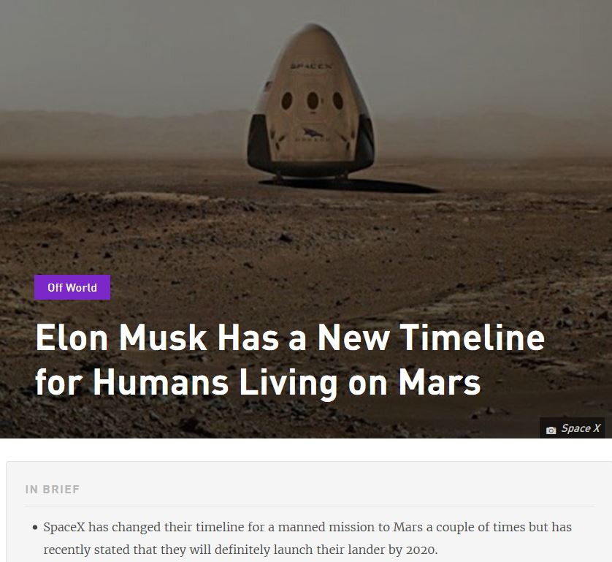
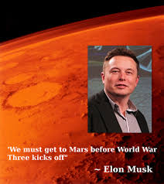
Immigrate to Mars?
Boldest nerd on earth!
Notes:
Elon Musk, the boldest man on earth, is working very hard to help human species survive in case something extinguish the dinosaurs would happen again.
Now the lattest new is he plan to put human being on Mars by 2020. That sounds like a perfect vision, right? (laugh)

Slide 4
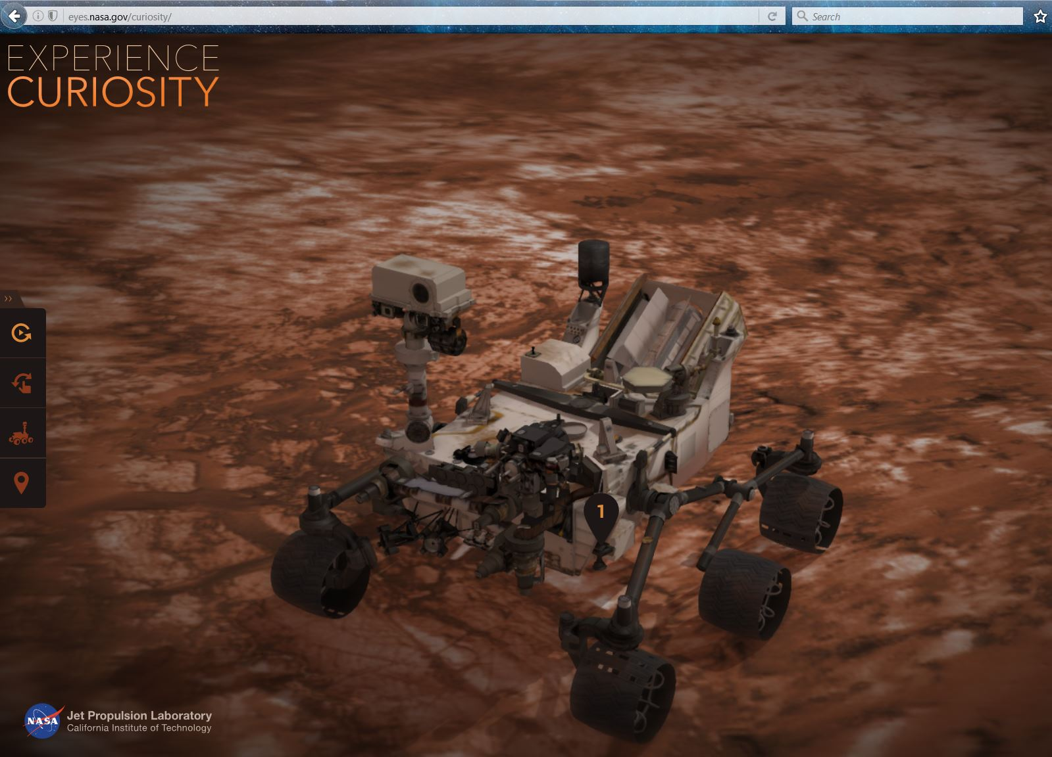
Is Mars habitable? Send Curiosity
Notes:
Before everything is possible, we have to do some homework. Is Mars habitable for life? NASA spend 8 years and more than 2 billion US dollars to build such an autonomous robot. Curiosity spend 8 month arrive at Mars on 2012. The distance between earth and Mars varies from 3 minute to 22 minutes in light speed.

Slide 5
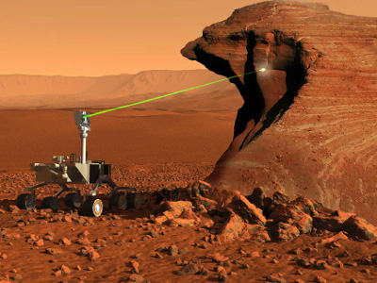
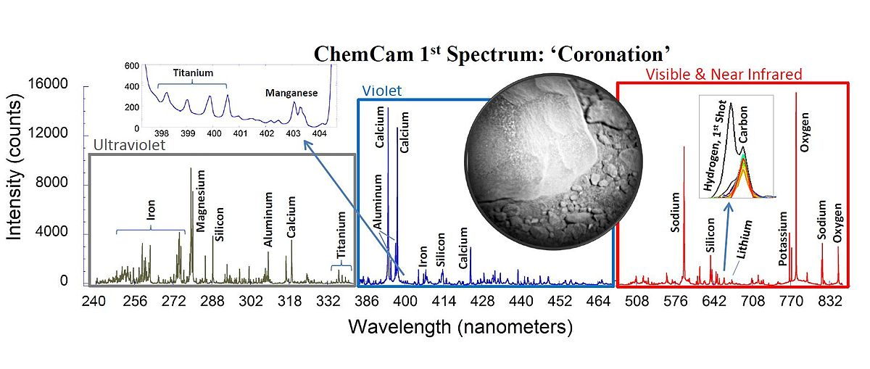
Zapping a rock
https://en.wikipedia.org/wiki/Curiosity_(rover)
- Use a 1067 nm laser to vaporize a rock or soil sample.
- then use ChemCam to observe the spectrum emitted by the vapor.
Notes:
If you want the animation, you will see curiosity zapping a rock. This looks super cool. What it actually does is …
If I want to be nerdy, I will say actually the laser light is invisible in this case. The animation is trying to entertain the general public and get everyone excited.

Slide 6
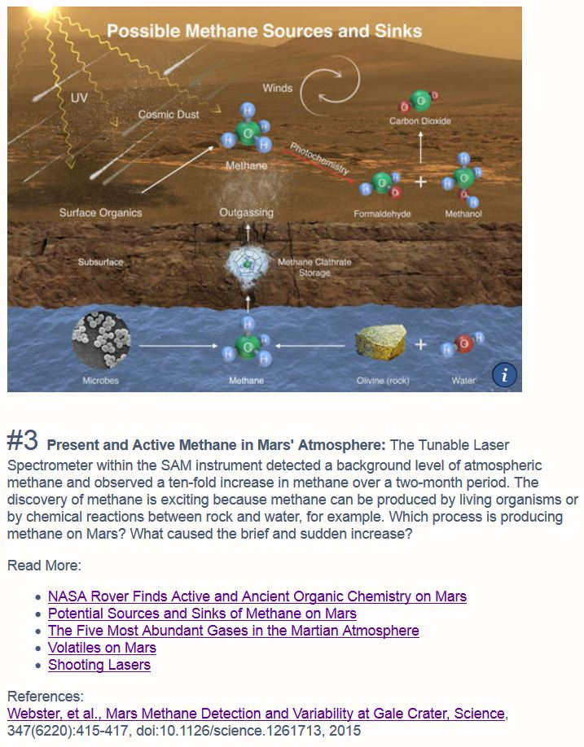
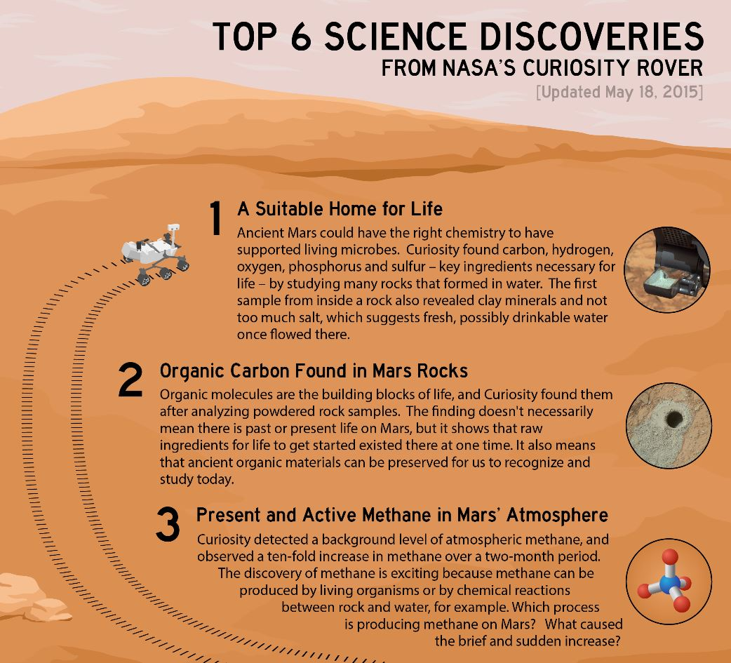
http://mars.nasa.gov/msl/mission/science/results/
Notes:
Now let’s see what are scientific discoveries by the curiosity rover. No.1. It found some key ingredients for life, such as carbon, hydrogen, oxygen ,phosphorous and sulfur. No. 2, it found organic molecules. No. 3, It found methane. It observe 10 fold increase in methand over a 2-month period. This is very exciting because methane is the very evidence of early life.

Slide 7
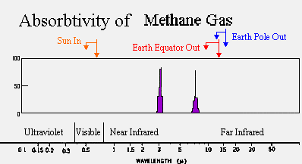
How to sense the invisible methane ?
Spectral signature
http://mb-soft.com/public3/methane.html
Most semiconductor lasers have their best performance at their material bandgaps.
supermarket scanner
blue-ray player
optical fiber lasers that power the whole internet

Slide 8
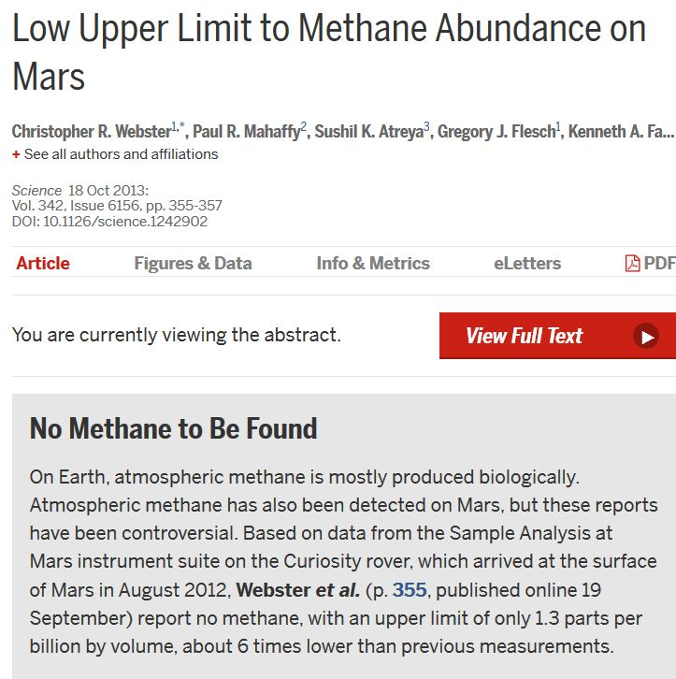
Sensing methane is difficult!
methane is a trace gas
real minority: parts per billion
One year after landing…
Notes:
Sensing methane is difficult

Slide 9
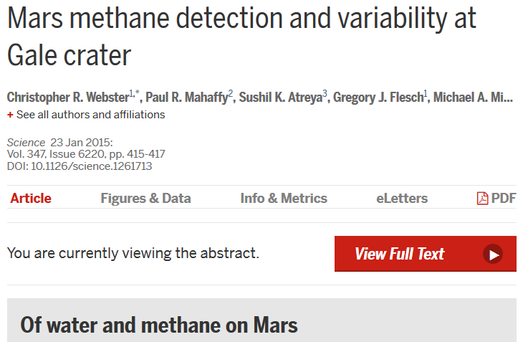
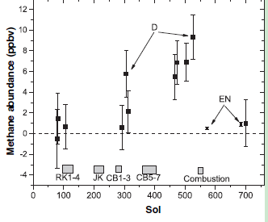
Sensing methane is difficult!
Another year passes…

Slide 10
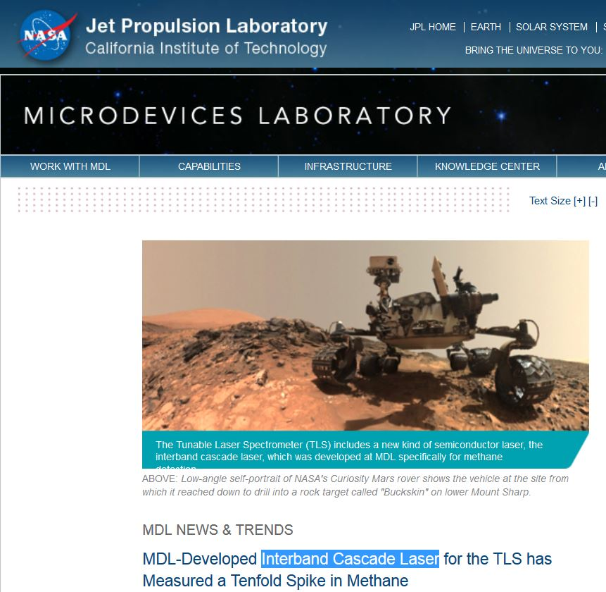
The secret weapon inside Curiosity
What’s special about interband cascade laser?

Slide 11
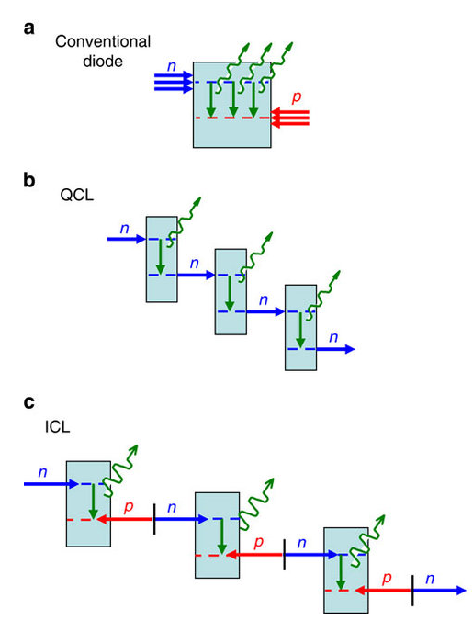
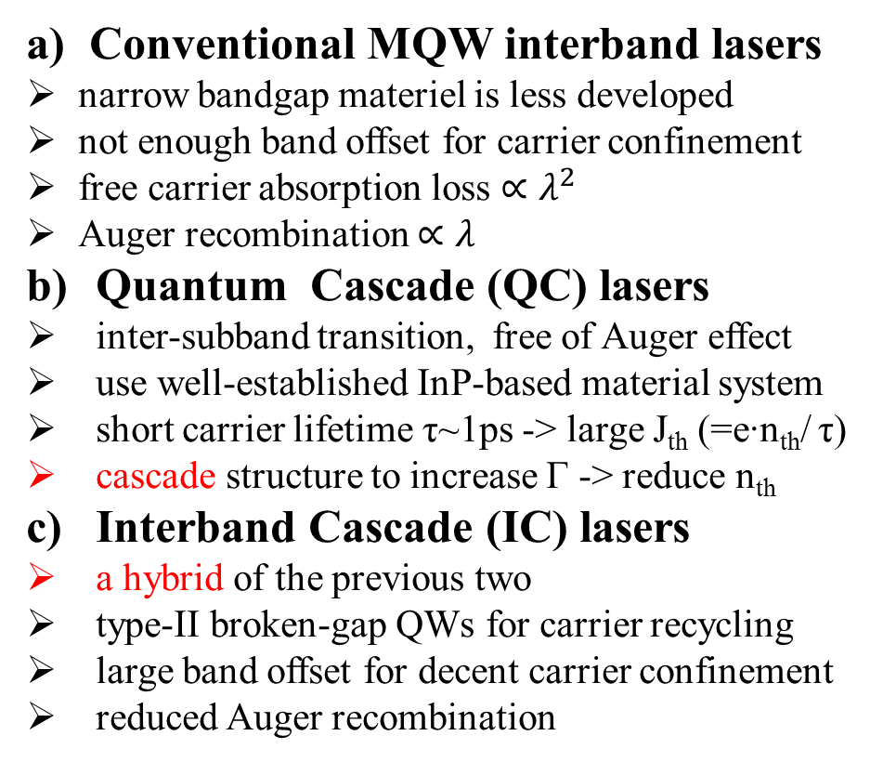
IC laser is a remix of two types of laser!
Conventional MQW interband lasers
narrow bandgap materiel is less developed
not enough band offset for carrier confinement
free carrier absorption loss $∝λ^{2}$
Auger recombination $∝λ$
Quantum Cascade (QC) lasers
inter-subband transition, free of Auger effect
use well-established InP-based material system
short carrier lifetime τ~1ps -> large J_{th} (=e∙n_{th}/ τ)
cascade structure to increase Γ -> reduce n_{th}
Interband Cascade (IC) lasers
a hybrid of the previous two
type-II broken-gap QWs for carrier recycling
large band offset for decent carrier confinement
reduced Auger recombination
http://www.nature.com/articles/ncomms1595

Slide 12
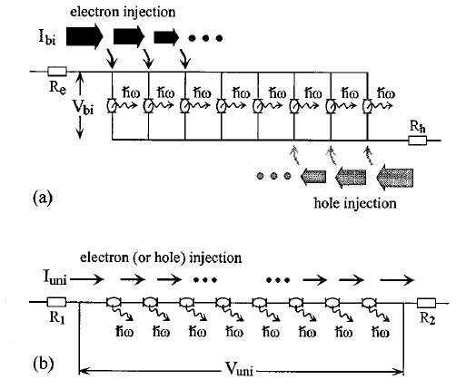
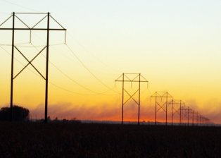
IC laser is a remix
not interested in quantum mechanics? use a circuit model.
 | type | equivalent circuit | key difference
a | MQW laser | in parallel | low voltage
b | IC laser | in series | low current
Similar to power transmission line:
(higher voltage, lower current)-> lower ohmic loss

Slide 13
Why IC laser is picked by NASA?
It is extremely energy efficient! Required minimum input power is only 1/10 of competing laser technology (i.e., QC laser)
State-of-the-art IC laser only needs 0.2 W.
iphone 6 battery (10.5 Wh) can power a IC laser to work for ~50 continuous hours.
Curiosity uses nuclear battery (thermal -> electricity), no solar panel due to dust & shade.

Slide 14
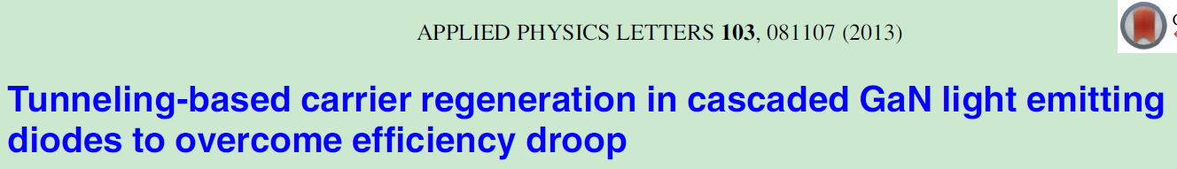
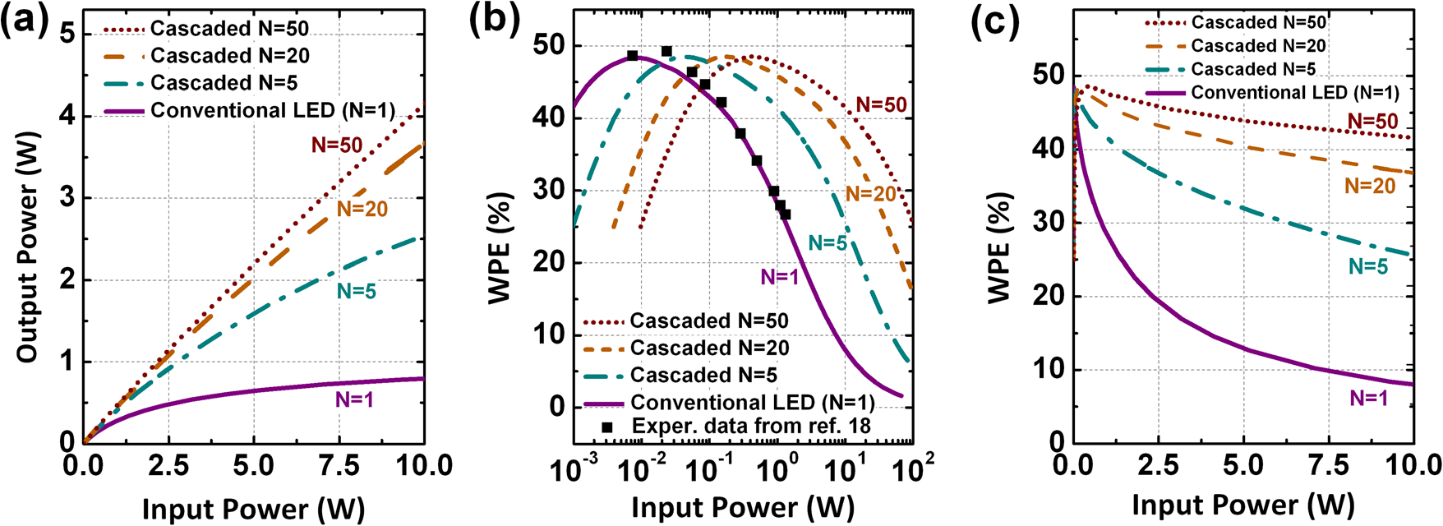
Remix apply to blue LED

Slide 15
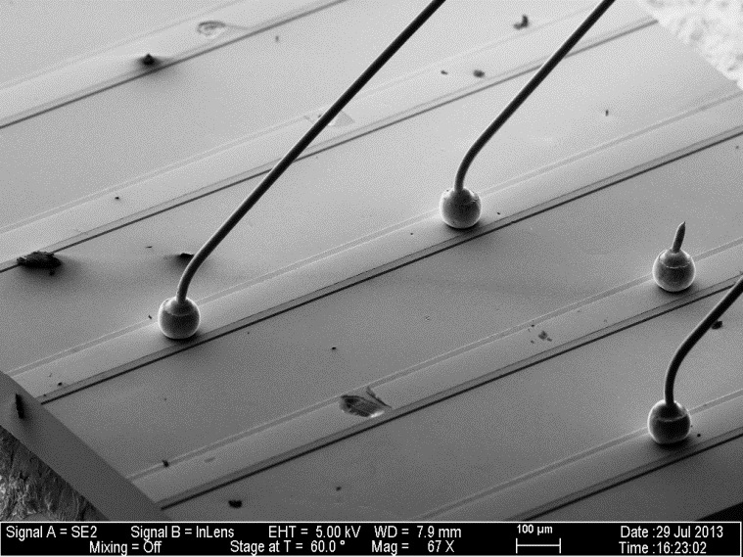
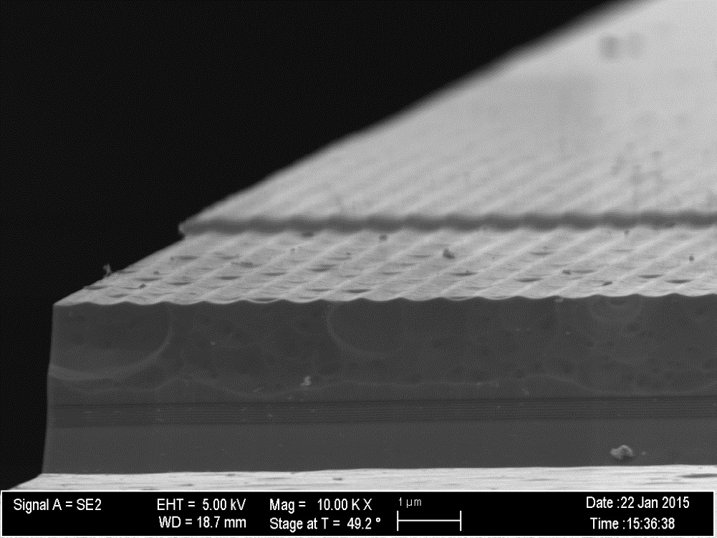
Real device & testing set-up
Laser
LN₂
Laser mesa
Trench
Current in
200 μm
Side
view
Temperature
Controller
Cryostat
Semiconductor grating
Vacuum
Top spacer
sensor A
Light
out
heater
Cascade stages
sensor B
Bottom spacer
1 μm

Slide 16
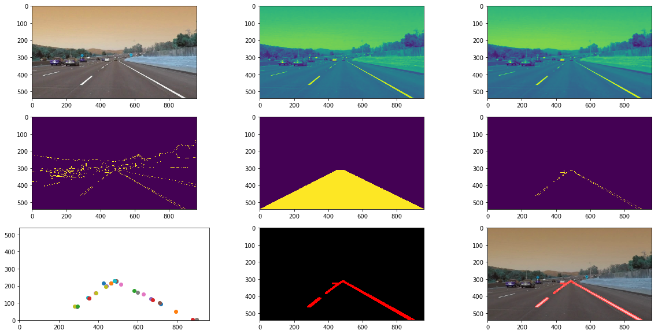
Why I am here?
In my previous life, I was a laser scientist.
Now I’ve been repurposed as a data scientist and machine learning engineer.
I share my learning at http://www.yuchao.us/
Notes:
I traditional research spends too much time on producing and collecting data.

Slide 17
Back up (technical details)

Slide 18
Curiosity budget
Total cost $2.5 B for 8 years
Equals to $1 for every American. In comparison, we spent $51 B on pets annually=$163 per person
launch cost account for 20%, provided by United Launch Alliance (= Boeing + Lockheed Martin)

Slide 19
Why interband cascade (IC) lasers? vs. quantum cascade (QC) lasers
Only two technologies capable of CW RT in mid-IR
 | QC laser | IC laser
material system | InGaAs/InAlAs/InP | InAs/GaSb/AlSb
carrier transition, lifetime | inter-subband, ~1 ps | interband, ~1 ns
threshold current density | 860 A/cm² @4.6μm | 100 A/cm² @3.6μm
threshold voltage | 12.8 V (40 stages) | 3 V (10 stages)
threshold power density | 11 kW/cm² | 0.3 kW/cm²
maximum output power | 5.1 W | 0.6 W
thermal conductivity | InP: 68 W/m∙K | GaSb:33; InAs:27
ref: APL, 95,141113 (2009) ; APL, 102,231123(2013)
APL, 89,181102 (2011); Opt Exp., 22,7702(2014)
IC laser is a better solution for battery powered applications.

Slide 20
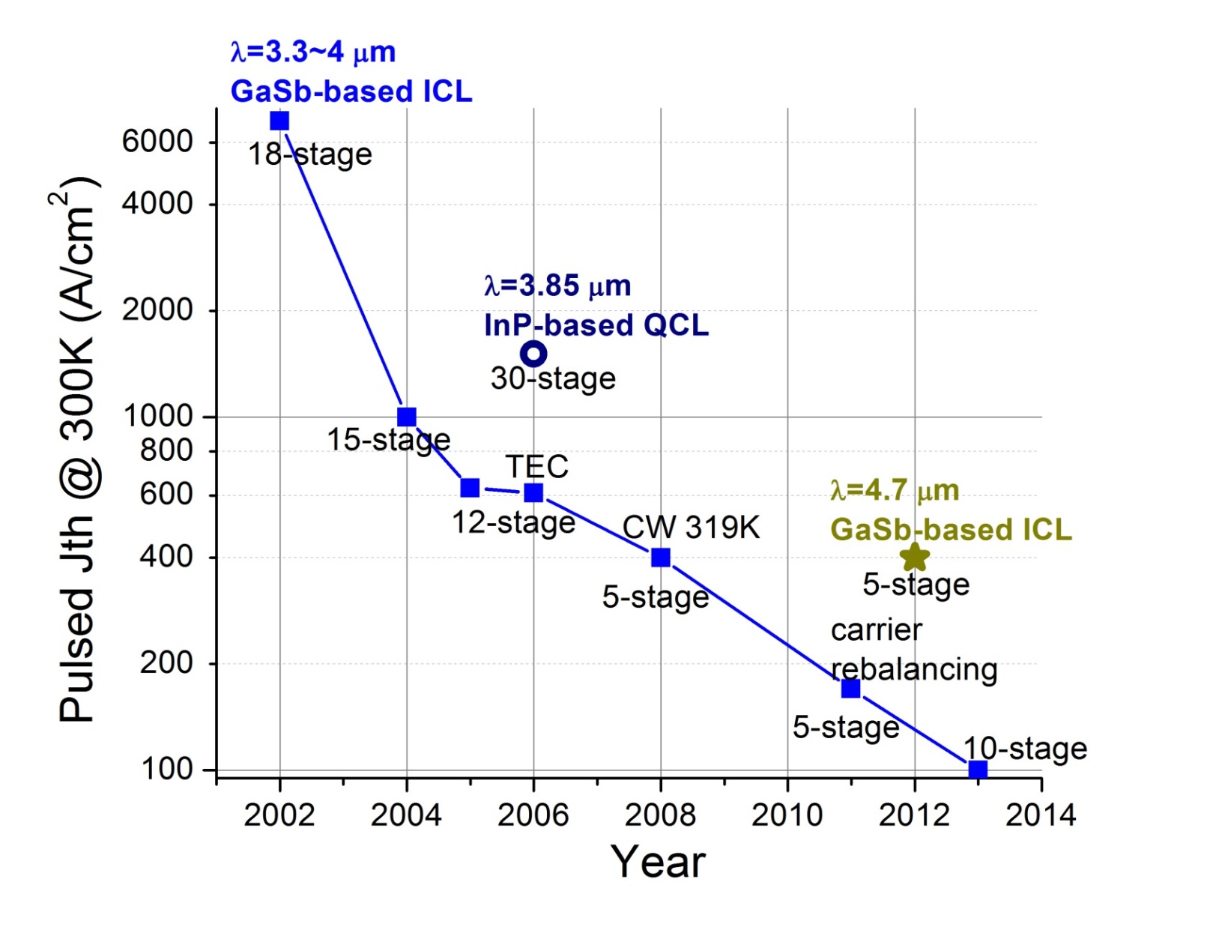
Snapshot of IC laser development
How the progress is made?
better material & fabrication
improved understanding & design
trial and error

Slide 21
Band structure of IC laser
bias
Design innovations since the prototype by R. Yang in 1994:
“W” like active region
2 QWs in hole injector
fine tune barrier thickness
semi-metallic interface
shortened electron injector
“carrier rebalancing”
(not fully understood)
“Rebalancing of internally generated carriers for mid-infrared interband cascade lasers with very low power consumption”,
Vurgaftman, et al., Nature Communication, 2, 585 (2011)

Slide 22
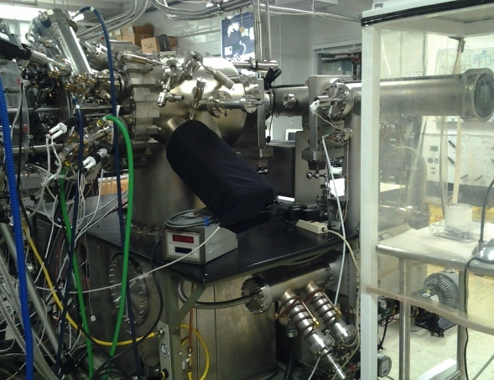
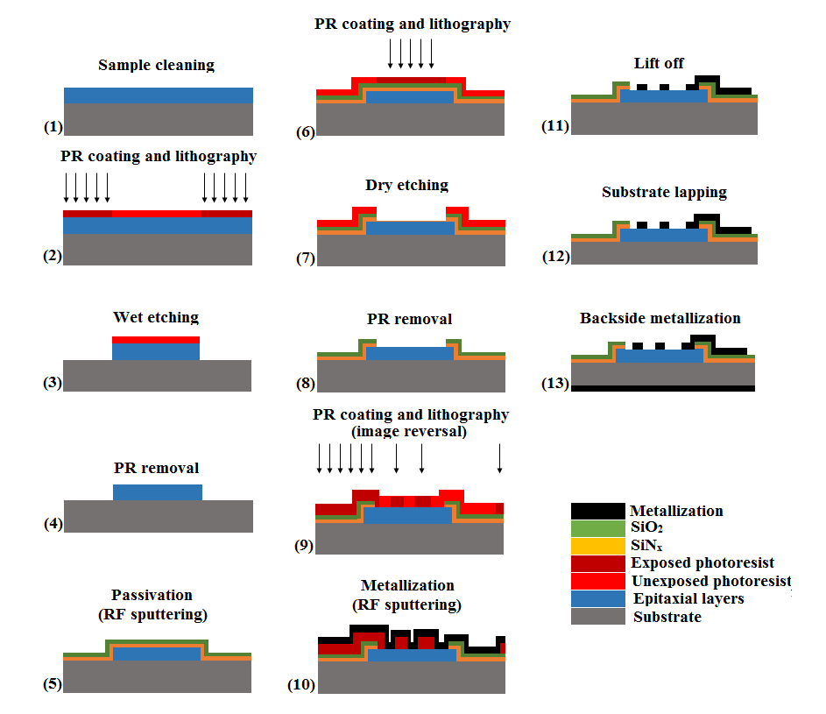
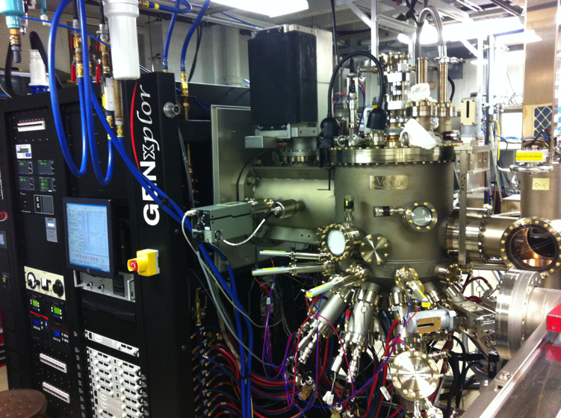
MBE growth and device fabrication

